Slide 1
Attention Span Detection in Online Instructor Led Sessions

Slide 2
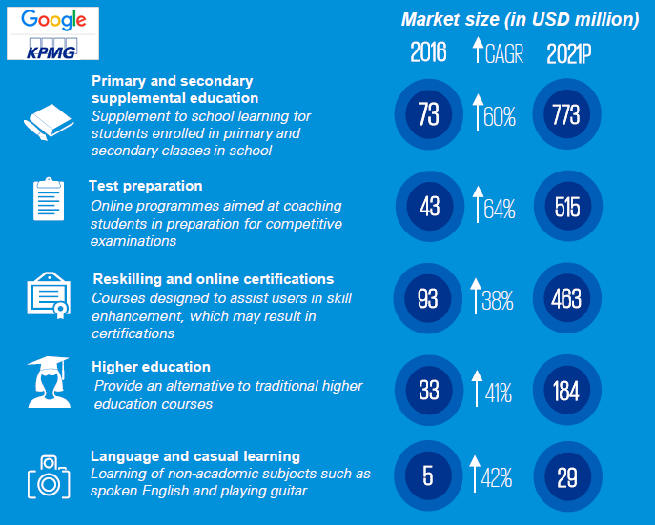
Online education
2016 - 2021
Approximately 8x growth
$1.96 Bn by 2021
Internet Access and Devices
Convenience
Flexibility
Personalisation
Notes:
Online education in India will see approximately 8x growth in the next five years, says a recent report by Google, KPMG.
This will have a significant impact on the edtech market that has a potential to touch $1.96 Bn by 2021 from where it stands now i.e. $247 Mn.
The fact that smartphones and mobile data are becoming even more mainstream and there is growing familiarity with online payments, suggests that a very significant proportion of the audience will adopt or switch to a new-age learning mode.

Slide 3
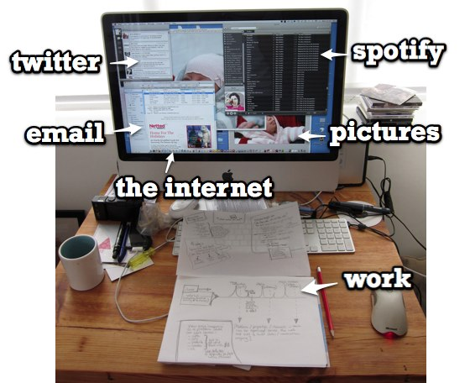


Online education - Distractions
Average Attention span in 1988 – 12 minutes
Average Attention span in 2018 – 5 minutes

Slide 4


Problem statement
To create a mechanism for monitoring and measuring the Attention span of the learners in online seminars.

Slide 5
Features
Eye position tracking
Blink rate detection
Positional changes - Restlessness
Ratio of one-way vs two-way conversation
Background noise
Real time dashboard – Participation of each user
Real time triggers in case of sub-optimal participation

Slide 6
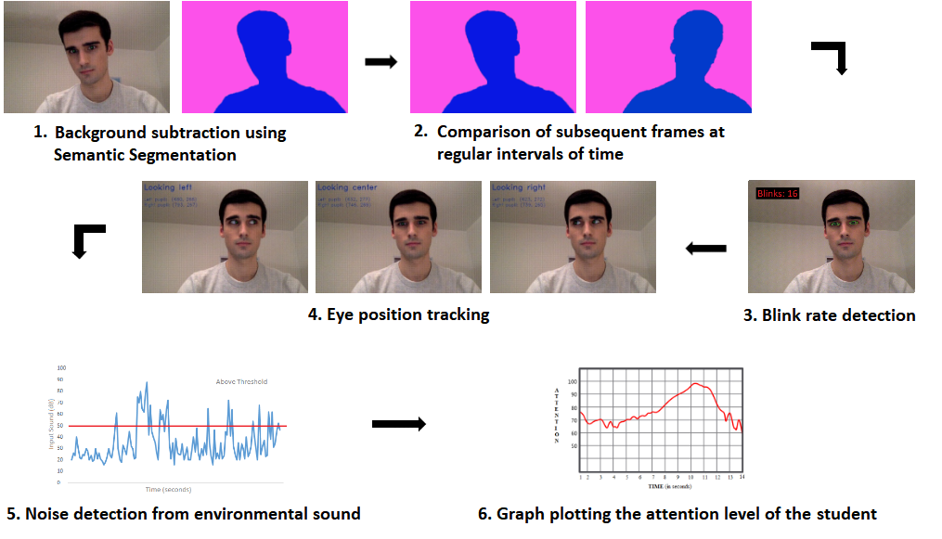
Solution steps

Slide 7



1. Background Subtraction using Semantic Segmentation
Input - Original image
Output - Semantic segmentation

Slide 8

2. Comparison of subsequent frames at regular intervals of time
Frame at T seconds
Frame at (T+3) seconds

Slide 9


3. Blink Rate Detection

Slide 10



4. Eye Position Tracking
Looking right
Looking center
Looking left

Slide 11
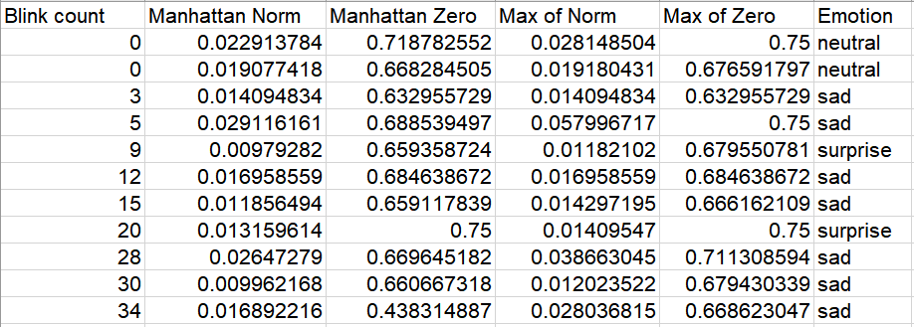
Data

Slide 12
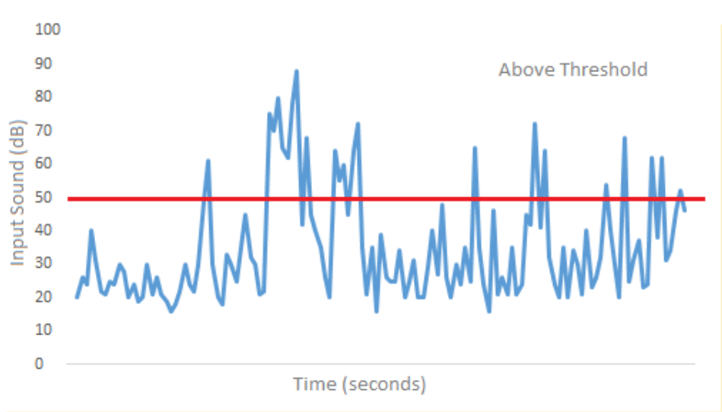
5. Noise level detection from environment sound
Noise

Slide 13
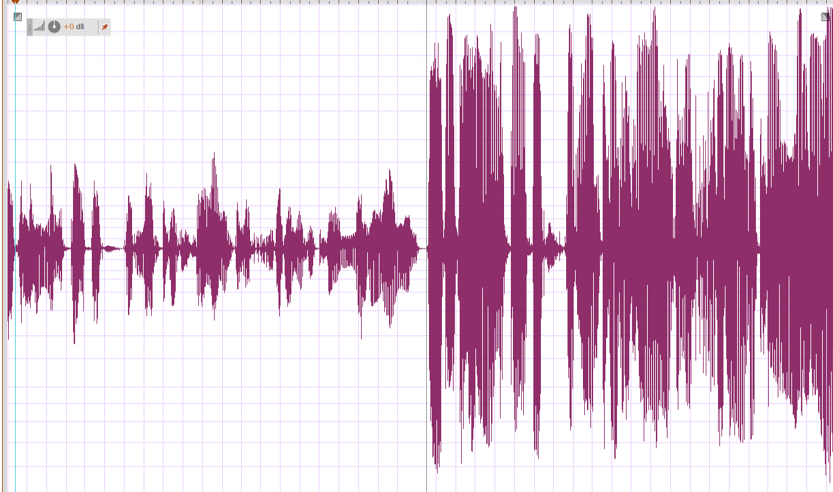
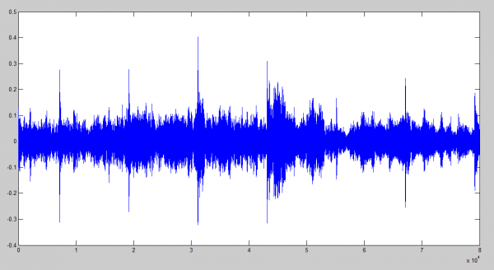
6. One way vs Two way conversation - Sound
Speaker output
Microphone input

Slide 14
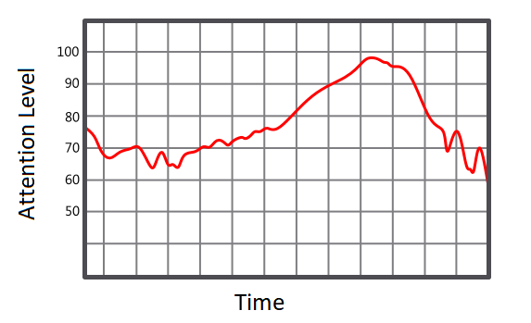
7. Graph plotting the Attention level

Slide 15



Alerts

Slide 16
Thank You

